Slide 1


Process Performance Baseline
Snapshot-V4.1
Version 4.0 | PPB Released
Version 4.1 | Improvement Targets updated after Audit on 2/20

Slide 2
SNAPSHOT
MBR 2- PPB has taken Productivity and DRE as Y Metrics.
Analysis is based on the data from the projects segregated first by verticals under P&C, Health and Exchange domains and second by type under Development and Maintenance projects.

Slide 3
EbixP&C PROJECT LIST
Project Type | Total Projects | Projects | Data Points
Development | 7 | EAW-FUMI | 8
 |  | EAW-Agency Portal (WMIC) | 1
 |  | eFinance | 2
 |  | eProfessional | 3
 |  | eProStar | 23
 |  | eProStar-Harmonized | 10
 |  | PPL | 3
Maintenance | 9 | Beazley | 1
 |  | EAW- Wolverine (BRICS) | 1
 |  | EbixASP | 5
 |  | iClose NextGen | 13
 |  | iClose Placement | 5
 |  | Marine Cargo | 7
 |  | RCS | 12
 |  | Risk Envision | 2
 |  | WCIRS | 13

Slide 4
EbixHealth PROJECT LIST
Project Type | Total Projects | Projects | Data Points
Development | 4 | ADAM | 26
 |  | EbixEnterprise | 21
 |  | IHC Markteplace CustomProjects | 2
 |  | TPACare | 6
Maintenance | 2 | Benergy | 6
 |  | LIN | 4
As EbixHealth Maintenance do not have sufficient data points to perform any analysis, this group is not considered further in this MBR.

Slide 5
EbixExchange PROJECT LIST
Project Type | Total Projects | Projects | Data Points
Development | 2 | AN4 | 7
 |  | STP | 5
Maintenance | 4 | ANW | 4
 |  | Max Life TPP | 5
 |  | SmartMonitor | 5
 |  | VSS | 5

Slide 6
PRODUCTIVITY ANALYSIS

Slide 7
EbixP&C DEVELOPMENT DATA FOR PRODUCTIVITY ANALYSIS
Actual Data | Productivity | 0.09 | 0.08 | 0.22 | 0.12 | 0.13 | 0.06 | 0.2 | 0.15 | 0.06 | 0.12 | 0.09 | 0.29 | 0.18 | 0.19 | 0.12
 | Coding Rate | 0.4 | 0.44 | 0.67 | 0.31 | 0.42 | 0.22 | 0.67 | 0.4 | 0.1 | 0.45 | 0.32 | 0.91 | 0.6 | 0.76 | 0.29
 | Analysis Rate | 0.25 | 0.7 | 0.63 | 0.42 | 0.42 | 1 | 1 | 1 | 0.33 | 0.78 | 0.6 | 2.11 | 1.32 | 0.72 | 0.61
Processed Data | Productivity | 0.09 | 0.08 | 0.22 | 0.12 | 0.13 | 0.06 | 0.2 | 0.15 | 0.06 | 0.12 | 0.09 | 0.27 | 0.18 | 0.19 | 0.12
 | Coding Rate | 0.4 | 0.44 | 0.67 | 0.31 | 0.42 | 0.22 | 0.67 | 0.4 | 0.1 | 0.45 | 0.32 | 0.91 | 0.6 | 0.76 | 0.29
 | Analysis Rate | 0.25 | 0.7 | 0.63 | 0.42 | 0.42 | 1 | 1 | 1 | 0.33 | 0.78 | 0.6 | 1.6 | 1.6 | 1.25 | 0.61
Actual Data | Productivity | 0.11 | 0.12 | 0.1 | 0.12 | 0.16 | 0.15 | 0.17 | 0.12 | 0.14 | 0.13 | 0.12 | 0.16 | 0.02 | 0.13 | 0.03
 | Coding Rate | 0.39 | 0.29 | 0.77 | 0.72 | 0.33 | 0.57 | 1.07 | 0.51 | 0.47 | 0.61 | 0.46 | 1 | 0.04 | 0.6 | 0.07
 | Analysis Rate | 1.76 | 1.22 | 0.95 | 1.55 | 1.24 | 0.91 | 0.73 | 0.71 | 0.63 | 0.88 | 0.51 | 0.9 | 0.31 | 0.33 | 0.08
Processed Data | Productivity | 0.11 | 0.12 | 0.1 | 0.12 | 0.16 | 0.15 | 0.17 | 0.12 | 0.14 | 0.13 | 0.12 | 0.16 | 0.02 | 0.13 | 0.03
 | Coding Rate | 0.39 | 0.29 | 0.77 | 0.72 | 0.33 | 0.57 | 1.07 | 0.51 | 0.47 | 0.61 | 0.46 | 1 | 0.04 | 0.6 | 0.07
 | Analysis Rate | 1.38 | 1.53 | 0.95 | 1.55 | 1.24 | 0.91 | 0.73 | 0.71 | 0.63 | 0.88 | 0.51 | 0.9 | 0.31 | 0.33 | 0.08

Slide 8
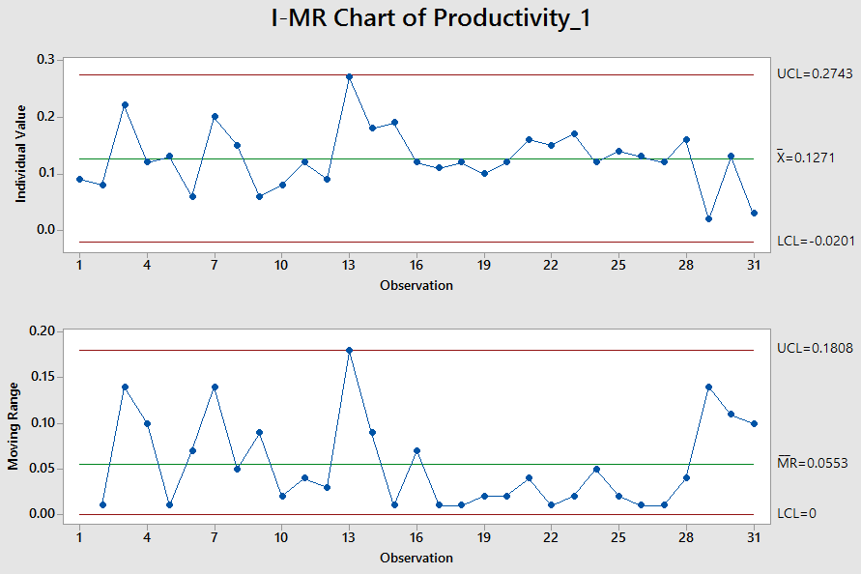
EbixP&C DEVELOPMENT
PRODUCTIVITY

Slide 9
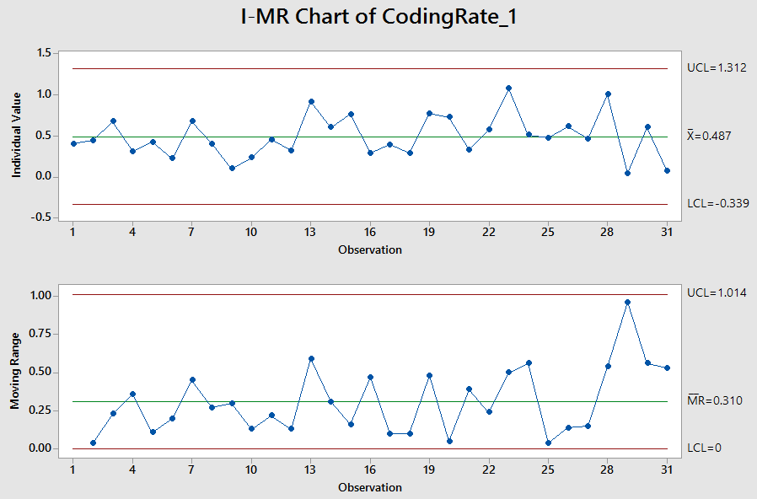
EbixP&C DEVELOPMENT
CODING RATE

Slide 10
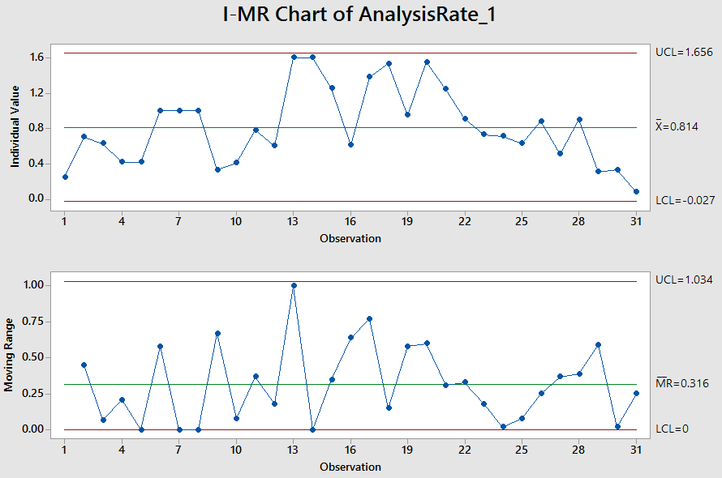
EbixP&C DEVELOPMENT
ANALYSIS RATE

Slide 11
EbixP&C DEVELOPMENT
CURRENT BASELINE & EQUATION
On basis of I-MR Analysis, current baselines are-
 | UCL | Mean | LCL | SD
Productivity | 0.27 | 0.13 | -0.02 | 0.05
Coding Rate | 1.31 | 0.49 | -0.34 | 0.28
Analysis Rate | 1.66 | 0.81 | -0.03 | 0.28
Regression Equation –
Productivity = 0.0358 + 0.1277 Coding Rate + 0.0356 Analysis Rate

Slide 12
EbixP&C DEVELOPMENT PRODUCTIVITY
PROCESS PERFORMANCE MODEL
Regression Equation –
Productivity = 0.0358 + 0.1277 Coding Rate + 0.0356 Analysis Rate
Predictor | Coef | SE Coef | T-Value | P-Value
Constant | 0.0358 | 0.0151 | 2.37 | 0.025
Coding Rate | 0.1277 | 0.0270 | 4.73 | 0.000
Analysis Rate | 0.0356 | 0.0159 | 2.24 | 0.033
S = 0.033882 R-Sq = 62.11% R-Sq(adj) = 59.41%
Analysis of Variance
Source | DF | Adj SS | Adj MS | F-Value | P-Value
Regression | 2 | 0.052695 | 0.026347 | 22.95 | 0.000
Residual Error | 28 | 0.032144 | 0.001148
Total | 30 | 0.084839

Slide 13
EbixP&C DEVELOPMENT PRODUCTIVITY
WHAT IF ANALYSIS
S. No. | Productivity | Coding Rate | Analysis Rate
1 | 0.13 | 0.49 | 0.81
2 | 0.13 | 0.51 | 0.85
3 | 0.14 | 0.55 | 0.88
4 | 0.14 | 0.6 | 0.9
5 | 0.15 | 0.65 | 1

Slide 14
EbixP&C DEVELOPMENT PRODUCTIVITY
IMPROVEMENT TARGET
Setting improvement targets-
I | USL | Target Mean | LSL | SD
Productivity | 0.30 | 0.15 | 0.00 | 0.05
Coding Rate | 1.48 | 0.65 | -0.18 | 0.28
Analysis Rate | 1.84 | 1.00 | 0.16 | 0.28

Slide 15
EbixP&C MAINTENANCE DATA FOR PRODUCTIVITY ANALYSIS
Actual Data | Productivity | 0.11 | 0.19 | 0.19 | 0.38 | 0.15 | 0.13 | 0.12 | 0.19 | 0.2 | 0.14 | 0.13 | 0.11 | 0.05 | 0.2 | 0.18 | 0.22
 | Coding Rate | 0.95 | 0.65 | 0.51 | 0.75 | 0.55 | 0.55 | 0.51 | 0.39 | 0.64 | 0.38 | 0.61 | 0.55 | 0.25 | 0.64 | 0.5 | 0.67
 | Analysis Rate | 0.48 | 0.77 | 0.86 | 2.93 | 1.18 | 1.35 | 0.63 | 1.31 | 1.13 | 0.62 | 2 | 0.65 | 0.47 | 1.75 | 4 | 2
Processed Data | Productivity | 0.11 | 0.16 | 0.19 | 0.31 | 0.15 | 0.13 | 0.12 | 0.19 | 0.2 | 0.14 | 0.13 | 0.11 | 0.05 | 0.2 | 0.18 | 0.22
 | Coding Rate | 0.95 | 0.8 | 0.6 | 0.75 | 0.55 | 0.55 | 0.51 | 0.39 | 0.64 | 0.38 | 0.61 | 0.55 | 0.25 | 0.64 | 0.5 | 0.67
 | Analysis Rate | 0.48 | 0.99 | 0.86 | 2.5 | 1.18 | 1.35 | 0.63 | 1.31 | 1.13 | 0.62 | 1.4 | 0.65 | 0.47 | 1.2 | 3.5 | 2.8
Actual Data | Productivity | 0.24 | 0.19 | 0.02 | 0.03 | 0.14 | 0.18 | 0.2 | 0.21 | 0.05 | 0.2 | 0.22 | 0.19 | 0.1 | 0.06 | 0.37 | 0.14
 | Coding Rate | 0.8 | 0.42 | 0.06 | 0.19 | 0.61 | 0.45 | 1.3 | 0.44 | 0.36 | 0.43 | 1.26 | 0.87 | 0.36 | 0.27 | 0.62 | 0.33
 | Analysis Rate | 2 | 5 | 0.06 | 0.11 | 2 | 2.62 | 3.25 | 2.13 | 0.29 | 6 | 1.17 | 0.76 | 0.28 | 0.25 | 2.17 | 0.25
Processed Data | Productivity | 0.24 | 0.19 | 0.02 | 0.03 | 0.14 | 0.18 | 0.2 | 0.21 | 0.05 | 0.2 | 0.22 | 0.19 | 0.1 | 0.06 | 0.3 | 0.14
 | Coding Rate | 0.8 | 0.42 | 0.06 | 0.19 | 0.61 | 0.45 | 1.18 | 0.44 | 0.36 | 0.43 | 1.19 | 0.87 | 0.36 | 0.27 | 0.62 | 0.33
 | Analysis Rate | 3 | 2.5 | 0.1 | 0.11 | 2 | 2.62 | 3.15 | 2.13 | 0.29 | 3.55 | 1.35 | 0.76 | 0.28 | 0.25 | 2.17 | 1.72

Slide 16
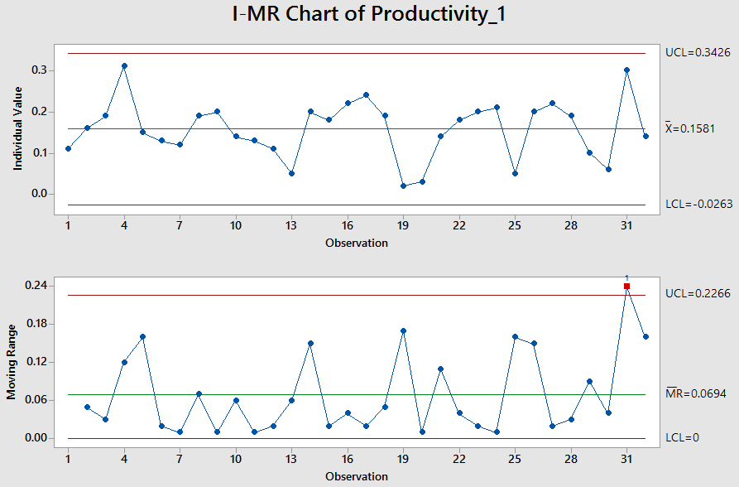
EbixP&C MAINTENANCE
PRODUCTIVITY

Slide 17
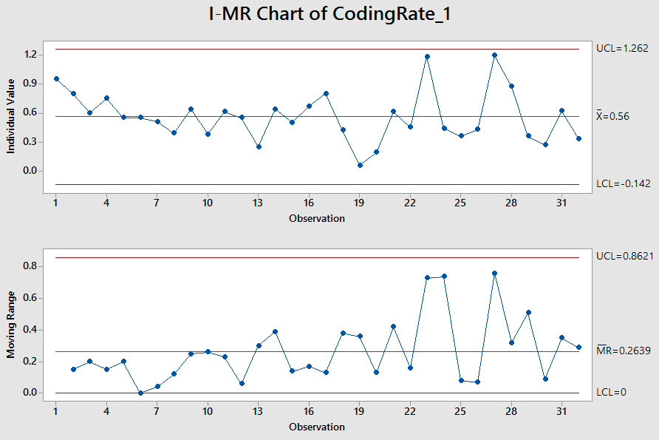
EbixP&C MAINTENANCE
CODING RATE

Slide 18
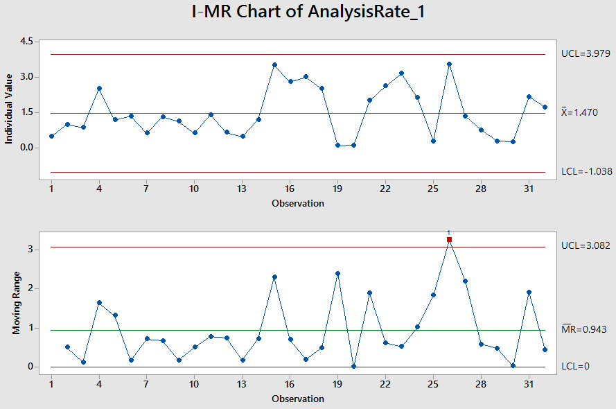
EbixP&C MAINTENANCE
ANALYSIS RATE

Slide 19
EbixP&C MAINTENANCE
CURRENT BASELINE & EQUATION
On basis of I-MR Analysis, current baselines are-
 | UCL | Mean | LCL | SD
Productivity | 0.34 | 0.16 | -0.03 | 0.06
Coding Rate | 1.26 | 0.56 | -0.14 | 0.23
Analysis Rate | 3.98 | 1.47 | -1.04 | 0.84
Regression Equation –
Productivity = 0.0415 + 0.1063 Coding Rate + 0.03879 Analysis Rate

Slide 20
EbixP&C MAINTENANCE PRODUCTIVITY
PROCESS PERFORMANCE MODEL
Regression Equation –
Productivity = 0.0415 + 0.1063 Coding Rate + 0.03879 Analysis Rate
Predictor | Coef | SE Coef | T-Value | P-Value
Constant | 0.0415 | 0.0199 | 2.09 | 0.046
Coding Rate | 0.1063 | 0.0327 | 3.25 | 0.003
Analysis Rate | 0.03879 | 0.00807 | 4.80 | 0.000
S = 0.442605 R-Sq = 62.84% R-Sq(adj) = 60.28%
Analysis of Variance
Source | DF | Adj SS | Adj MS | F-Value | P-Value
Regression | 2 | 0.09608 | 0.048038 | 24.52 | 0.000
Residual Error | 29 | 0.05681 | 0.001959
Total | 31 | 0.15289

Slide 21
EbixP&C MAINTENANCE PRODUCTIVITY
WHAT IF ANALYSIS
S. No. | Productivity | Coding Rate | Analysis Rate
1 | 0.16 | 0.56 | 1.47
2 | 0.16 | 0.6 | 1.5
3 | 0.17 | 0.65 | 1.55
4 | 0.18 | 0.7 | 1.6
5 | 0.19 | 0.75 | 1.65

Slide 22
EbixP&C MAINTENANCE PRODUCTIVITY
IMPROVEMENT TARGET
Setting improvement targets-
I | USL | Target Mean | LSL | SD
Productivity | 0.37 | 0.19 | 0.01 | 0.06
Coding Rate | 1.45 | 0.75 | 0.05 | 0.23
Analysis Rate | 4.16 | 1.65 | -0.86 | 0.84

Slide 23
EbixHealth DEVELOPMENT DATA FOR PRODUCTIVITY ANALYSIS
Actual Data | Productivity | 0.16 | 0.2 | 0.15 | 0.17 | 0.17 | 0.1 | 0.16 | 0.34 | 0.18 | 0.25 | 0.3 | 0.23 | 0.11
 | Coding Rate | 1.67 | 1.43 | 0.74 | 8.73 | 1.19 | 0.19 | 3.41 | 7.61 | 7.4 | 1.24 | 0.63 | 0.45 | 0.88
 | Analysis Rate | 0.42 | 0.61 | 0.39 | 0.31 | 6.54 | 10 | 8.62 | 13.11 | 5.36 | 5 | 9.32 | 3.85 | 10.29
Processed Data | Productivity | 0.16 | 0.2 | 0.15 | 0.17 | 0.17 | 0.1 | 0.16 | 0.34 | 0.18 | 0.25 | 0.3 | 0.23 | 0.11
 | Coding Rate | 1.67 | 1.43 | 0.74 | 0.87 | 1.2 | 0.19 | 0.9 | 1.5 | 0.74 | 1.24 | 0.8 | 0.45 | 0.5
 | Analysis Rate | 0.42 | 0.61 | 0.39 | 0.31 | 4.5 | 3.45 | 2.5 | 4.6 | 4 | 3.5 | 3.8 | 3.85 | 4
Actual Data | Productivity | 0.29 | 0.1 | 0.26 | 0.19 | 0.21 | 0.27 | 0.27 | 0.32 | 0.28 | 0.28 | 0.16 | 0.21
 | Coding Rate | 0.5 | 0.16 | 3 | 0.47 | 0.83 | 2.58 | 1.96 | 5 | 1.2 | 1.7 | 1.16 | 0.7
 | Analysis Rate | 2.5 | 15 | 18.13 | 9.09 | 2.32 | 2.79 | 2.65 | 5 | 4.67 | 11.5 | 0.86 | 2.35
Processed Data | Productivity | 0.29 | 0.1 | 0.26 | 0.19 | 0.21 | 0.3 | 0.27 | 0.32 | 0.28 | 0.28 | 0.16 | 0.21
 | Coding Rate | 0.7 | 0.16 | 1.5 | 0.47 | 1.7 | 1.97 | 1.96 | 2.17 | 1.2 | 1.7 | 1.16 | 1.1
 | Analysis Rate | 3.8 | 1.8 | 3.6 | 2.8 | 2.32 | 2.79 | 2.65 | 3.5 | 4.4 | 4.2 | 0.86 | 2.35
Actual Data | Productivity | 0.19 | 0.21 | 0.24 | 0.22 | 0.18 | 0.23 | 0.11 | 0.21 | 0.16 | 0.22 | 0.26 | 0.22 | 0.12
 | Coding Rate | 1 | 0.73 | 1.69 | 0.89 | 0.82 | 0.86 | 0.35 | 0.67 | 0.55 | 0.87 | 1.18 | 0.5 | 0.23
 | Analysis Rate | 1.44 | 2.51 | 0.88 | 2.09 | 1.24 | 3.22 | 0.93 | 2.47 | 1 | 2.47 | 2.12 | 2.55 | 1.13
Processed Data | Productivity | 0.19 | 0.21 | 0.24 | 0.22 | 0.18 | 0.23 | 0.11 | 0.21 | 0.16 | 0.22 | 0.26 | 0.22 | 0.12
 | Coding Rate | 1 | 0.73 | 1.69 | 0.89 | 0.82 | 0.86 | 0.35 | 0.67 | 0.55 | 0.87 | 1.18 | 0.5 | 0.23
 | Analysis Rate | 1.44 | 2.51 | 0.88 | 2.09 | 1.24 | 3.22 | 0.93 | 2.47 | 1 | 2.47 | 2.12 | 2.55 | 1.13

Slide 24
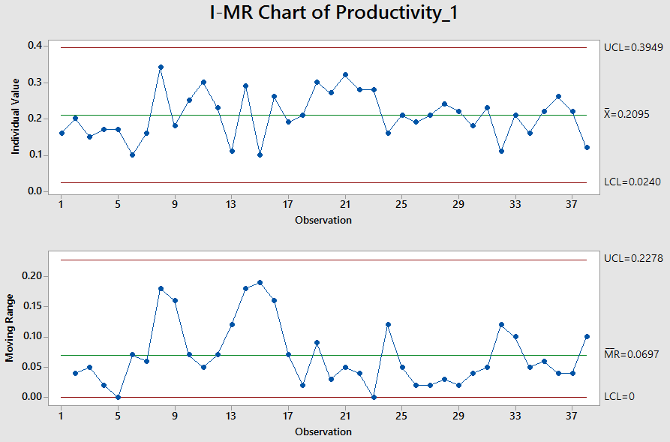
EbixHealth DEVELOPMENT
PRODUCTIVITY

Slide 25
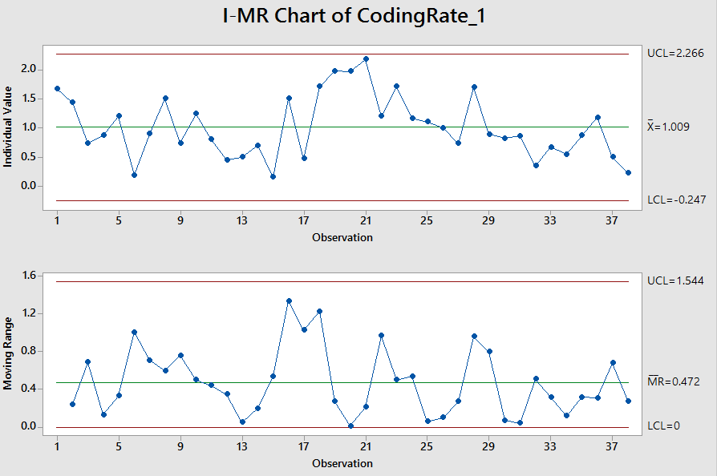
EbixHealth DEVELOPMENT
CODING RATE

Slide 26
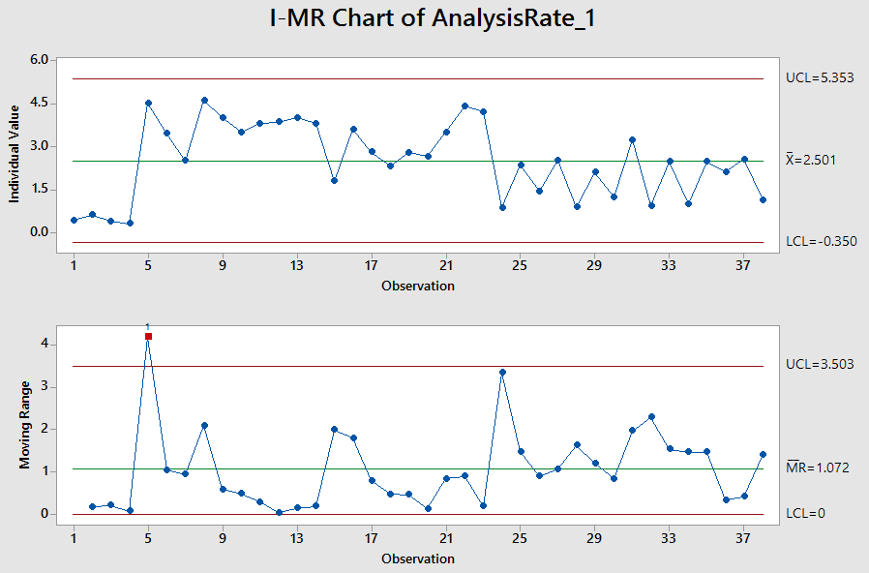
EbixHealth DEVELOPMENT
ANALYSIS RATE

Slide 27
EbixHealth DEVELOPMENT
CURRENT BASELINE & EQUATION
On basis of I-MR Analysis, current baselines are-
 | UCL | Mean | LCL | SD
Productivity | 0.39 | 0.21 | 0.02 | 0.06
Coding Rate | 2.27 | 1.01 | -0.25 | 0.42
Analysis Rate | 5.35 | 2.50 | -0.35 | 0.95
Regression Equation –
Productivity = 0.0845 + 0.0718 Coding Rate + 0.02100 Analysis Rate

Slide 28
EbixHealth DEVELOPMENT PRODUCTIVITY
PROCESS PERFORMANCE MODEL
Regression Equation –
Productivity = 0.0845 + 0.0718 Coding Rate + 0.02100 Analysis Rate
Predictor | Coef | SE Coef | T-Value | P-Value
Constant | 0.0845 | 0.0186 | 4.55 | 0.000
Coding Rate | 0.0718 | 0.0128 | 5.62 | 0.000
Analysis Rate | 0.02100 | 0.00518 | 4.05 | 0.000
S = 0.0406433 R-Sq = 60.23% R-Sq (adj) = 57.96%
Analysis of Variance
Source | DF | Adj SS | Adj MS | F-Value | P-Value
Regression | 2 | 0.08757 | 0.043787 | 26.51 | 0.000
Residual Error | 35 | 0.05782 | 0.001652
Total | 37 | 0.14539

Slide 29
EbixHealth DEVELOPMENT PRODUCTIVITY
WHAT IF ANALYSIS
S. No. | Productivity | Coding Rate | Analysis Rate
1 | 0.21 | 1.01 | 2.50
2 | 0.22 | 1.1 | 2.6
3 | 0.23 | 1.2 | 2.7
4 | 0.23 | 1.25 | 2.8
5 | 0.24 | 1.3 | 3

Slide 30
EbixHealth DEVELOPMENT PRODUCTIVITY
IMPROVEMENT TARGET
Setting improvement targets-
I | USL | Target Mean | LSL | SD
Productivity | 0.43 | 0.24 | 0.05 | 0.06
Coding Rate | 2.56 | 1.30 | 0.04 | 0.42
Analysis Rate | 5.85 | 3.00 | 0.15 | 0.95

Slide 31
EbixExchange DEVELOPMENT DATA FOR PRODUCTIVITY ANALYSIS
Actual Data | Productivity | 0.13 | 0.13 | 0.16 | 0.16 | 0.2 | 0.28 | 0.29 | 0.16 | 0.14
 | Coding Rate | 0.35 | 0.49 | 0.64 | 0.44 | 0.43 | 0.84 | 0.8 | 0.61 | 0.55
 | Analysis Rate | 2 | 2 | 0.87 | 0.53 | 1.24 | 1.95 | 1.6 | 1 | 1.6
Processed Data | Productivity | 0.13 | 0.13 | 0.16 | 0.16 | 0.2 | 0.26 | 0.26 | 0.16 | 0.14
 | Coding Rate | 0.35 | 0.15 | 0.64 | 0.44 | 0.43 | 0.84 | 0.8 | 0.61 | 0.55
 | Analysis Rate | 2 | 1.3 | 0.87 | 0.53 | 1.24 | 1.95 | 1.6 | 1 | 1.6

Slide 32
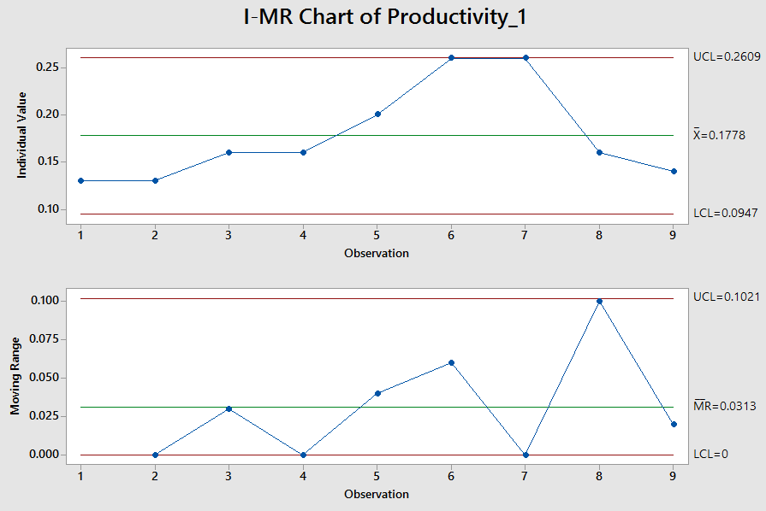
EbixExchange DEVELOPMENT
PRODUCTIVITY

Slide 33
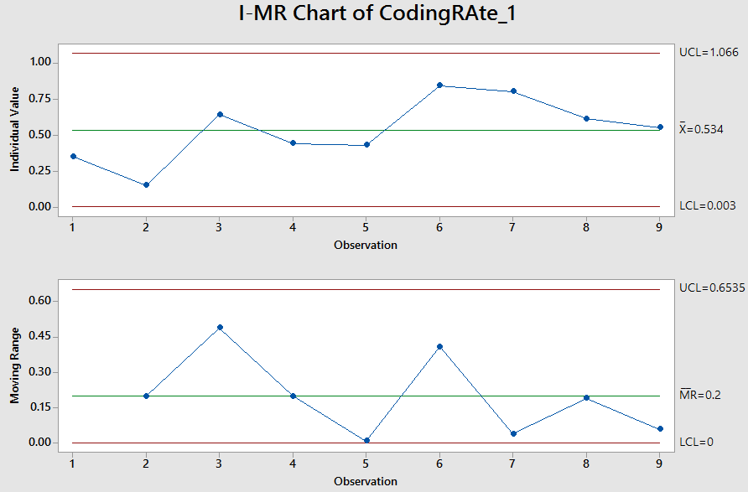
EbixExchange DEVELOPMENT CODING RATE

Slide 34
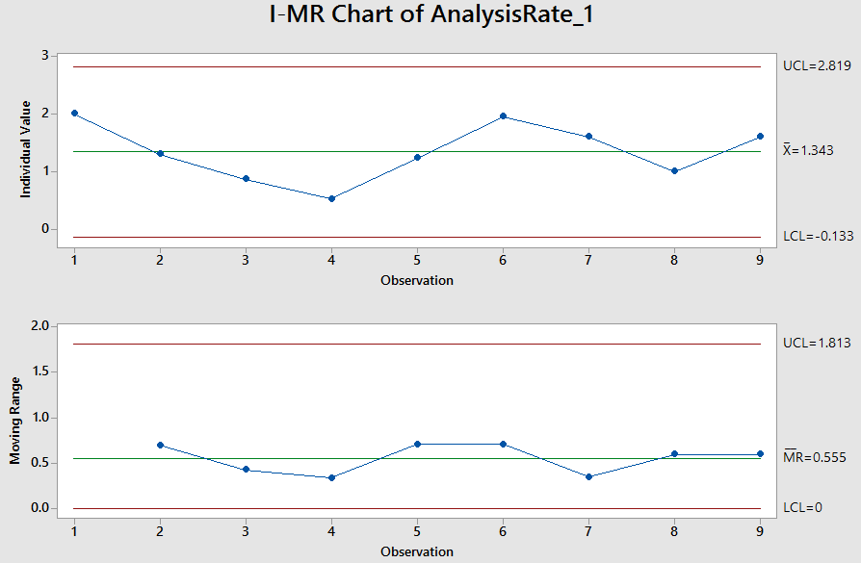
EbixExchange DEVELOPMENT ANALYSIS RATE

Slide 35
EbixExchange DEVELOPMENT
CURRENT BASELINE & EQUATION
On basis of I-MR Analysis, current baselines are-
 | UCL | Mean | LCL | SD
Productivity | 0.26 | 0.18 | 0.09 | 0.03
Coding Rate | 1.07 | 0.53 | 0.00 | 0.18
Analysis Rate | 2.82 | 1.34 | -0.13 | 0.49
Regression Equation –
Productivity = 0.0412 + 0.2092 Coding Rate + 0.0226 Analysis Rate

Slide 36
EbixExchange DEVELOPMENT PRODUCTIVITY
PROCESS PERFORMANCE MODEL
Regression Equation –
Productivity = 0.0412 + 0.2092 Coding Rate + 0.0226 Analysis Rate
Predictor | Coef | SE Coef | T-Value | P-Value
Constant | 0.0412 | 0.0525 | 0.78 | 0.463
Coding Rate | 0.2092 | 0.0702 | 2.98 | 0.025
Analysis Rate | 0.0226 | 0.0311 | 0.73 | 0.495
S = 0.0426255 R-Sq = 63.9% R-Sq (adj) = 51.87%
Analysis of Variance
Source | DF | Adj SS | Adj MS | F-Value | P-Value
Regression | 2 | 0.019298 | 0.009649 | 5.31 | 0.047
Residual Error | 6 | 0.010902 | 0.001817
Total | 8 | 0.030200

Slide 37
EbixExchange DEVELOPMENT
WHAT IF ANALYSIS
S. No. | Productivity | Coding Rate | Analysis Rate
1 | 0.18 | 0.53 | 1.34
2 | 0.2 | 0.6 | 1.4
3 | 0.21 | 0.65 | 1.5
4 | 0.22 | 0.7 | 1.6
5 | 0.23 | 0.7 | 1.8

Slide 38
EbixExchange DEVELOPMENT
IMPROVEMENT TARGET
Setting improvement targets-
I | USL | Target Mean | LSL | SD
Productivity | 0.31 | 0.23 | 0.15 | 0.03
Coding Rate | 1.23 | 0.70 | 0.17 | 0.18
Analysis Rate | 3.28 | 1.80 | 0.32 | 0.49

Slide 39
EbixExchange MAINTENANCE DATA FOR PRODUCTIVITY ANALYSIS
Actual Data | Productivity | 0.29 | 0.49 | 0.27 | 0.23 | 0.27 | 0.28 | 0.27 | 0.16
 | Coding Rate | 0.77 | 3.33 | 3.08 | 1.85 | 1.96 | 1.52 | 1.66 | 0.77
 | Analysis Rate | 2.5 | 1.76 | 0.7 | 0.89 | 1.17 | 1.09 | 1.22 | 0.34
Processed Data | Productivity | 0.29 | 0.49 | 0.27 | 0.23 | 0.27 | 0.28 | 0.27 | 0.16
 | Coding Rate | 0.77 | 2.50 | 2.50 | 1.85 | 1.96 | 1.52 | 1.66 | 0.77
 | Analysis Rate | 2.5 | 1.76 | 0.7 | 0.89 | 1.17 | 1.09 | 1.22 | 0.34
Actual Data | Productivity | 0.13 | 0.13 | 0.08 | 0.37 | 0.41 | 0.3 | 0.12 | 0.19
 | Coding Rate | 0.24 | 0.2 | 0.22 | 0.88 | 1.5 | 1.67 | 0.61 | 0.77
 | Analysis Rate | 0.73 | 1.48 | 0.4 | 1.66 | 0.8 | 1.02 | 0.29 | 0.49
Processed Data | Productivity | 0.13 | 0.13 | 0.08 | 0.37 | 0.41 | 0.3 | 0.12 | 0.19
 | Coding Rate | 0.24 | 0.2 | 0.22 | 0.88 | 1.5 | 1.67 | 0.61 | 0.77
 | Analysis Rate | 0.73 | 1.48 | 0.4 | 1.66 | 0.8 | 1.02 | 0.29 | 0.49

Slide 40
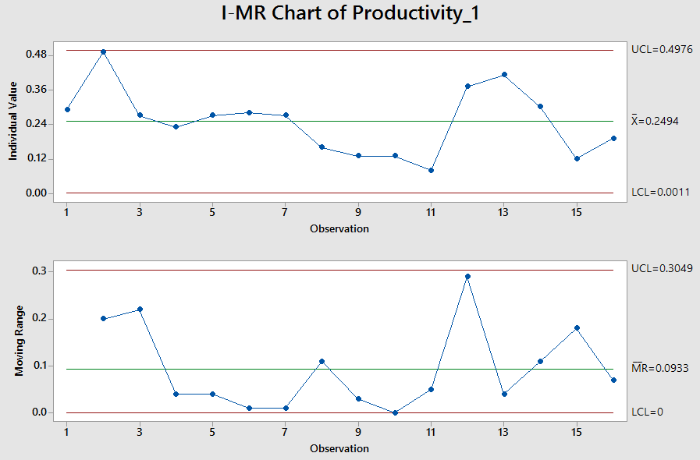
EbixExchange MAINTENANCE
PRODUCTIVITY

Slide 41
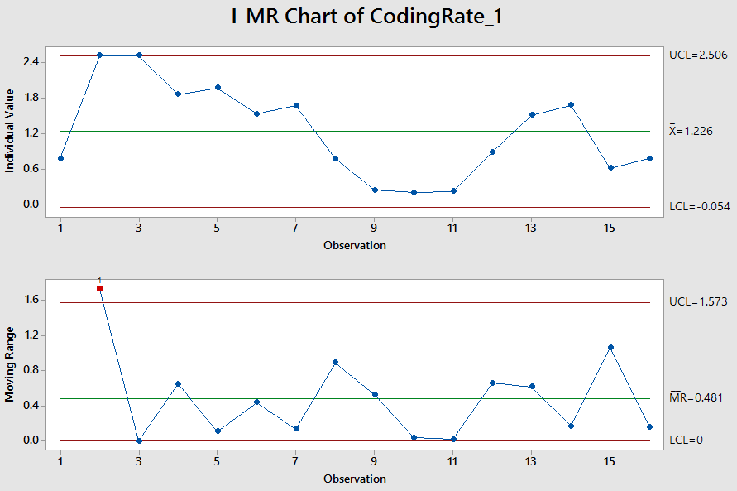
EbixExchange MAINTENANCE CODING RATE

Slide 42
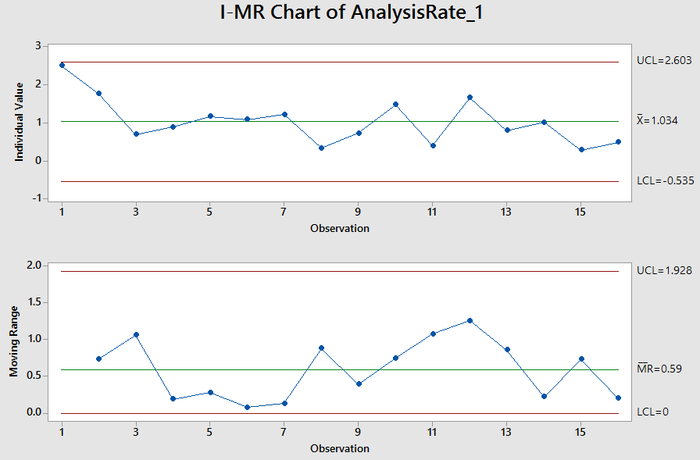
EbixExchange MAINTENANCE ANALYSIS RATE

Slide 43
EbixExchange MAINTENANCE
CURRENT BASELINE & EQUATION
On basis of I-MR Analysis, current baselines are-
 | UCL | Mean | LCL | SD
Productivity | 0.50 | 0.25 | 0.00 | 0.08
Coding Rate | 2.51 | 1.23 | -0.05 | 0.43
Analysis Rate | 2.60 | 1.03 | -0.54 | 0.52
Regression Equation –
Productivity = 0.0771 + 0.0641 Coding Rate + 0.0832 Analysis Rate

Slide 44
EbixExchange MAINTENANCE PRODUCTIVITY
PROCESS PERFORMANCE MODEL
Regression Equation –
Productivity = 0.0771 + 0.0641 Coding Rate + 0.0832 Analysis Rate
Predictor | Coef | SE Coef | T-Value | P-Value
Constant | 0.0771 | 0.0353 | 2.18 | 0.048
Coding Rate | 0.0641 | 0.0173 | 3.71 | 0.003
Analysis Rate | 0.0832 | 0.0277 | 3.01 | 0.010
S = 0.0628641 R-Sq = 69.14% R-Sq (adj) = 64.4%
Analysis of Variance
Source | DF | Adj SS | Adj MS | F-Value | P-Value
Regression | 2 | 0.11513 | 0.057563 | 14.57 | 0.000
Residual Error | 13 | 0.05137 | 0.003952
Total | 15 | 0.16650

Slide 45
EbixExchange MAINTENANCE
WHAT IF ANALYSIS
S. No. | Productivity | Coding Rate | Analysis Rate
1 | 0.24 | 1.23 | 1.03
2 | 0.25 | 1.3 | 1.1
3 | 0.27 | 1.5 | 1.2
4 | 0.28 | 1.5 | 1.3
5 | 0.3 | 1.5 | 1.5
6 | 0.31 | 1.6 | 1.6

Slide 46
EbixExchange MAINTENANCE IMPROVEMENT TARGET
Setting improvement targets-
I | USL | Target Mean | LSL | SD
Productivity | 0.56 | 0.31 | 0.06 | 0.08
Coding Rate | 2.88 | 1.60 | 0.32 | 0.43
Analysis Rate | 3.17 | 1.60 | 0.03 | 0.52

Slide 47
PRODUCTIVITY
IMPROVEMENT ACTION PLAN
Increase the analysis rate by doing effective requirement analysis, eliminating unclear and ambiguous requirements.
Increase the analysis rate by proper classification of work items at the time of their receipt (change request, enhancement, new requirement or bug)
Need to include the adjustment in Analysis Effort and Coding Effort from planning stage itself by a potential modification/customization of Estimation model
Above mentioned points may be achieved by:
Prototypes or mockups should be prepared and signed off before coding

Slide 48
PRODUCTIVITY
IMPROVEMENT ACTION PLAN
Team brainstorming for complex work items for better understanding of requirements and code logic to improve the coding rate
Creating Impact Analysis documents for complex or already identified requirements for improving Analysis Rate and Coding Rate
Conducting formal BA and developer sessions for better understanding and eliminating early ambiguity
Improvement action plan to be shared with Leadership Task Force in review meetings and reports to be presented when suggestions are implemented.

Slide 49
DRE ANALYSIS

Slide 50
EbixP&C DEVELOPMENT DATA FOR DRE ANALYSIS
Actual Data | Defect Removal Effectiveness | 85.29 | 84 | 100 | 88.24 | 92.86 | 100 | 100 | 83.33 | 95.24 | 78.95 | 89.47 | 94.2 | 90.91 | 75 | 85.71 | 80
 | Testing Time | 7.88 | 5.86 | 0.85 | 1.52 | 3 | 0 | 3 | 1.15 | 0.4 | 1.54 | 2.07 | 1.62 | 1.45 | 0.4 | 1.13 | 0.5
 | Review Time | 1.13 | 0.5 | 0.35 | 0.2 | 0.38 | 1 | 0.5 | 0.55 | 0.36 | 0.75 | 0.79 | 0.98 | 0.57 | 0.68 | 0.63 | 0.09
Processed Data | Defect Removal Effectiveness | 85.29 | 84 | 100 | 88.24 | 92.86 | 100 | 100 | 83.33 | 95.24 | 78.95 | 89.47 | 94.2 | 90.91 | 75 | 85.71 | 80
 | Testing Time | 3 | 2.75 | 4 | 1.52 | 3 | 3.74 | 3 | 1.15 | 2.3 | 1.54 | 2.07 | 1.62 | 1.45 | 0.4 | 1.13 | 0.5
 | Review Time | 0.7 | 0.5 | 0.8 | 0.2 | 0.38 | 0.8 | 0.5 | 0.55 | 0.9 | 0.75 | 0.79 | 0.98 | 0.57 | 0.68 | 0.63 | 0.45
Actual Data | Defect Removal Effectiveness | 94.94 | 78.57 | 75 | 75 | 100 | 68.63 | 75 | 94.53 | 87.88 | 90.91 | 100 | 86.75 | 66.67 | 80 | 100
 | Testing Time | 1.04 | 2.13 | 0.92 | 4 | 2.94 | 0.48 | 2 | 1.88 | 1.54 | 2.58 | 3.11 | 1.63 | 2.55 | 2.32 | 2.67
 | Review Time | 0.08 | 0.13 | 0.13 | 1.1 | 0.21 | 0.13 | 0.5 | 0.51 | 0.19 | 0.24 | 0.14 | 0.24 | 0.16 | 0.74 | 0.92
Processed Data | Defect Removal Effectiveness | 94.94 | 78.57 | 77 | 76 | 100 | 68.63 | 74 | 94.53 | 87.88 | 90.91 | 100 | 86.75 | 66.67 | 80 | 100
 | Testing Time | 2.04 | 2.13 | 0.92 | 1.5 | 2.94 | 0.48 | 2 | 1.88 | 1.54 | 2.58 | 3.11 | 1.63 | 1.1 | 2.32 | 2.67
 | Review Time | 0.8 | 0.13 | 0.13 | 0.5 | 0.7 | 0.13 | 0.5 | 0.6 | 0.3 | 0.42 | 0.81 | 0.24 | 0.16 | 0.74 | 0.98

Slide 51
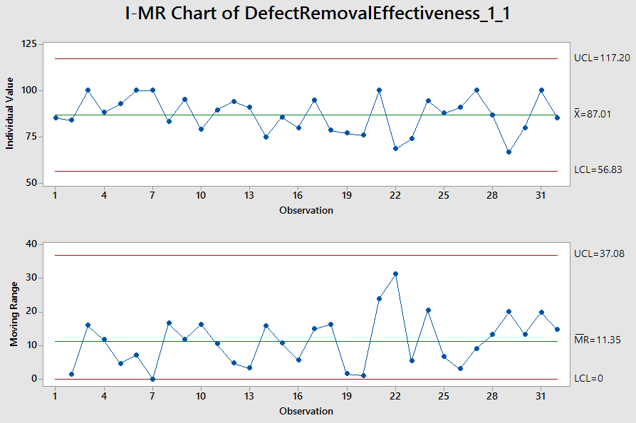
EbixP&C DEVELOPMENT
DEFECT REMOVAL EFFECTIVENESS

Slide 52
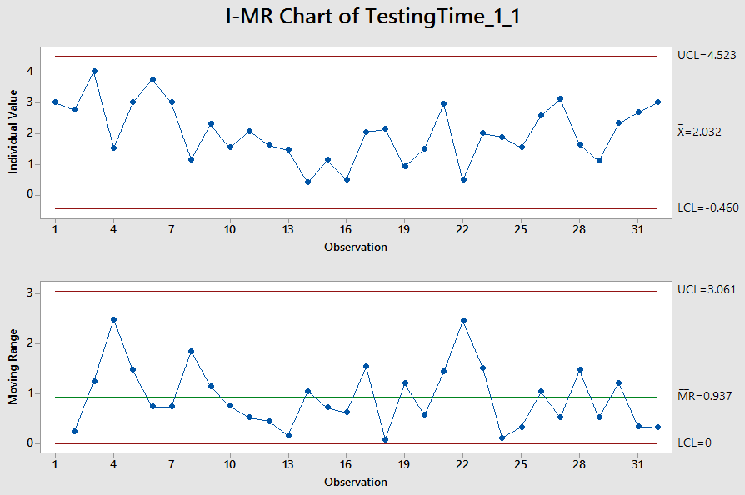
EbixP&C DEVELOPMENT TESTING TIME

Slide 53
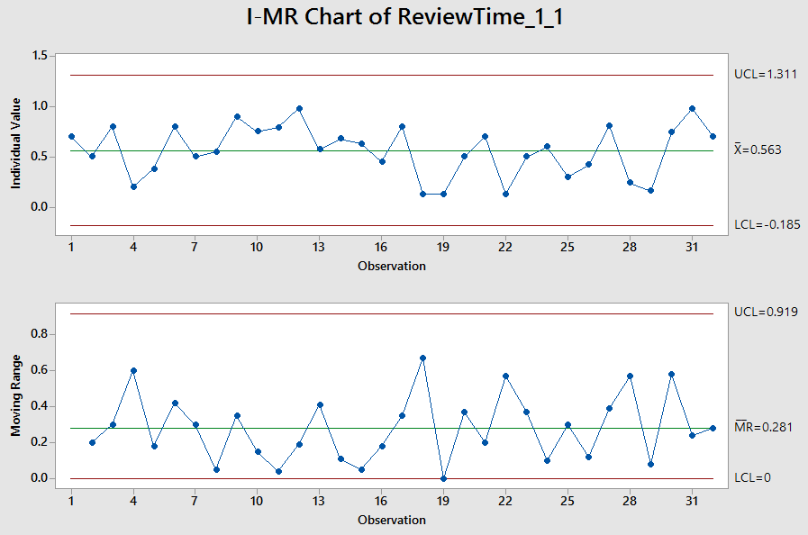
EbixP&C DEVELOPMENT REVIEW TIME

Slide 54
EbixP&C DEVELOPMENT
CURRENT BASELINE & EQUATION
On basis of I-MR Analysis, current baselines are-
 | UCL | Mean | LCL | SD
Defect Removal Effectiveness | 117.2 | 87.01 | 56.83 | 10.06
Testing Time | 4.52 | 2.03 | -0.46 | 0.93
Review Time | 1.31 | 0.56 | -0.19 | 0.25
Regression Equation –
Defect Removal Effectiveness (DRE) = 67.80 + 5.97 Testing Time + 13.09 Review Time

Slide 55
EbixP&C DEVELOPMENT DRE
PROCESS PERFORMANCE MODEL
Regression Equation –
DRE = 67.80 + 5.97 Testing Time + 13.09 Review Time
Predictor | Coef | SE Coef | T-Value | P-Value
Constant | 67.80 | 3.19 | 21.27 | 0.000
Testing Time | 5.97 | 1.39 | 4.30 | 0.000
Review Time | 13.09 | 5.01 | 2.61 | 0.014
S = 6.36064 R-Sq = 60.56% R-Sq (adj) = 57.75%
Analysis of Variance
Source | DF | Adj SS | Adj MS | F-Value | P-Value
Regression | 2 | 1739.6 | 869.80 | 21.50 | 0.000
Residual Error | 28 | 1132.8 | 40.46
Total | 30 | 2872.4

Slide 56
EbixP&C DEVELOPMENT WHAT IF ANALYSIS
S. No. | Defect Removal Effectiveness | Testing Time | Review Time
1 | 87.19 | 2.02 | 0.56
2 | 88.19 | 2.1 | 0.6
3 | 89.44 | 2.2 | 0.65
4 | 90.69 | 2.3 | 0.7

Slide 57
EbixP&C DEVELOPMENT IMPROVEMENT TARGET
Setting improvement targets-
I | USL | Target Mean | LSL | SD
Defect Removal Effectiveness | 120.88 | 90.69 | 60.50 | 10.06
Testing Time | 5.09 | 2.3 | -0.49 | 0.93
Review Time | 1.45 | 0.7 | -0.05 | 0.25

Slide 58
EbixP&C MAINTENANCE DATA FOR DRE ANALYSIS
Actual Data | Defect Removal Effectiveness | 100 | 50 | 85.71 | 60 | 100 | 100 | 50 | 100 | 75 | 60 | 100 | 100
 | Testing Time | 3.05 | 1.98 | 1.12 | 1.97 | 3.2 | 1.65 | 0.97 | 1.44 | 1.82 | 3.7 | 2.86 | 0.14
 | Review Time | 0.22 | 0.11 | 0.05 | 0.05 | 0.04 | 0.24 | 0.05 | 0.07 | 0.06 | 0.2 | 0.09 | 0.29
Processed Data | Defect Removal Effectiveness | 100 | 50 | 85.71 | 60 | 100 | 100 | 50 | 100 | 75 | 60 | 100 | 100
 | Testing Time | 3.05 | 0.88 | 1.12 | 1.25 | 3.2 | 1.65 | 0.97 | 2.44 | 1.82 | 1.5 | 2.86 | 1
 | Review Time | 0.22 | 0.09 | 0.37 | 0.07 | 0.52 | 0.24 | 0.05 | 0.07 | 0.06 | 0.2 | 0.09 | 0.5
Actual Data | Defect Removal Effectiveness | 100 | 100 | 94.03 | 90.32 | 85.71 | 94.12 | 89.29 | 100 | 71.43 | 40 | 61.36 | 100
 | Testing Time | 1.38 | 2 | 2.57 | 1.54 | 0.77 | 0.56 | 3.5 | 0.83 | 0.89 | 0.38 | 0.96 | 2
 | Review Time | 0.5 | 0.4 | 0.32 | 0.31 | 0.12 | 0.28 | 0.92 | 0.33 | 0.59 | 0.12 | 0.25 | 0.1
Processed Data | Defect Removal Effectiveness | 100 | 100 | 94.03 | 90.32 | 85.71 | 94.12 | 89.29 | 100 | 71.43 | 40 | 61.36 | 100
 | Testing Time | 1.38 | 2 | 2.57 | 1.54 | 1.5 | 2.56 | 1.4 | 1.8 | 0.89 | 0.28 | 0.96 | 2
 | Review Time | 0.5 | 0.4 | 0.32 | 0.31 | 0.12 | 0.28 | 0.5 | 0.33 | 0.18 | 0.08 | 0.25 | 0.1

Slide 59
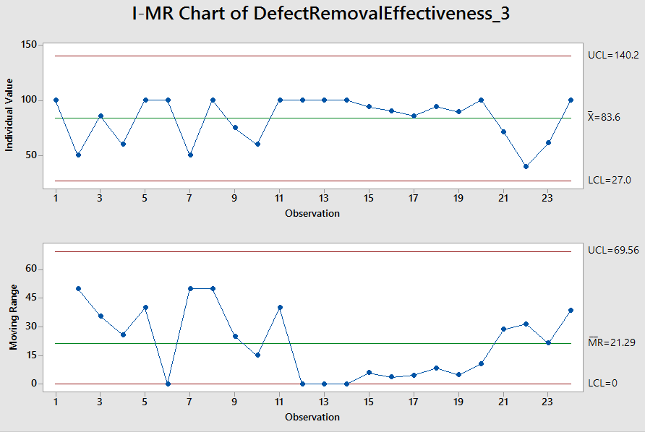
EbixP&C MAINTENANCE
DEFECT REMOVAL EFFECTIVENESS

Slide 60
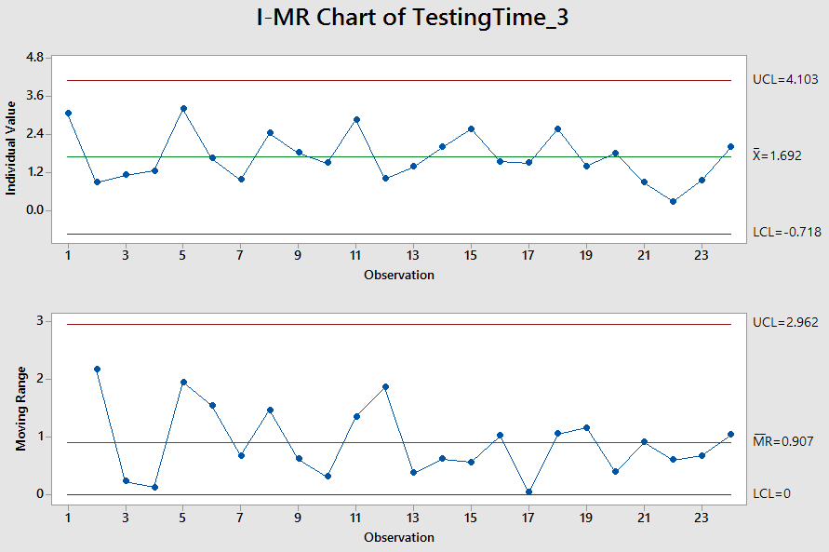
EbixP&C MAINTENANCE TESTING TIME

Slide 61
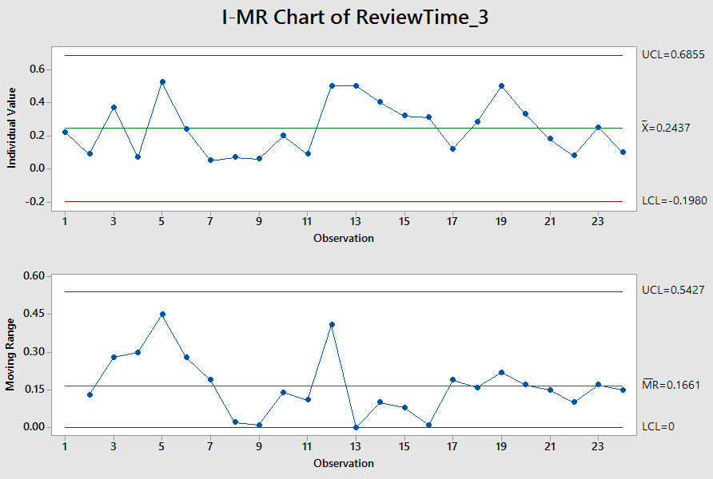
EbixP&C MAINTENANCE REVIEW TIME

Slide 62
EbixP&C MAINTENANCE
CURRENT BASELINE & EQUATION
On basis of I-MR Analysis, current baselines are-
 | UCL | Mean | LCL | SD
Defect Removal Effectiveness | 140.2 | 83.6 | 27 | 16.23
Testing Time | 4.10 | 1.69 | -0.72 | 0.44
Review Time | 0.69 | 0.24 | -0.20 | 0.10
Regression Equation –
Defect Removal Effectiveness (DRE) = 42.87 + 16.28 Testing Time + 54.2 Review Time

Slide 63
EbixP&C MAINTENANCE DRE
PROCESS PERFORMANCE MODEL
Regression Equation –
DRE = 42.87 + 16.28 Testing Time + 54.2 Review Time
Predictor | Coef | SE Coef | T-Value | P-Value
Constant | 42.87 | 6.79 | 6.31 | 0.000
Testing Time | 16.28 | 3.31 | 4.92 | 0.000
Review Time | 54.2 | 15.9 | 3.41 | 0.003
S = 11.9880 R-Sq = 66.41% R-Sq (adj) = 63.21%
Analysis of Variance
Source | DF | Adj SS | Adj MS | F-Value | P-Value
Regression | 2 | 5967 | 2983.5 | 20.76 | 0.000
Residual Error | 21 | 3018 | 143.7
Total | 23 | 8985

Slide 64
EbixP&C MAINTENANCE WHAT IF ANALYSIS
S. No. | Defect Removal Effectiveness | Testing Time | Review Time
1 | 83.59 | 1.69 | 0.24
2 | 86.81 | 1.7 | 0.3
3 | 88.7 | 1.75 | 0.32
4 | 90.06 | 1.8 | 0.33
5 | 91.42 | 1.85 | 0.34

Slide 65
EbixP&C MAINTENANCE IMPROVEMENT TARGET
Setting improvement targets-
I | USL | Target Mean | LSL | SD
Defect Removal Effectiveness | 140.12 | 91.42 | 42.72 | 16.23
Testing Time | 3.16 | 1.85 | 0.54 | 0.44
Review Time | 0.64 | 0.34 | 0.04 | 0.10

Slide 66
EbixHealth DEVELOPMENT DATA FOR DRE ANALYSIS
Actual Data | Defect Removal Effectiveness | 83.33 | 90.7 | 52.15 | 54.84 | 62.5 | 92.86 | 95.24 | 98.65 | 86.21 | 85.71 | 62.5 | 71.43 | 100 | 56.58
 | Testing Time | 0.89 | 0.73 | 1.94 | 1.53 | 1.44 | 1.61 | 0.84 | 0.84 | 2.34 | 2.33 | 2.19 | 1.15 | 2.27 | 2.09
 | Review Time | 0.07 | 0.53 | 0.22 | 0.05 | 0.09 | 0.12 | 0.03 | 0.56 | 0.33 | 0.14 | 0.3 | 0.42 | 0.23 | 0.42
Processed Data | Defect Removal Effectiveness | 83.33 | 90.7 | 52.15 | 57.5 | 62.5 | 92.86 | 84 | 85 | 86.21 | 85.71 | 62.5 | 71.43 | 82 | 75
 | Testing Time | 1.7 | 1.89 | 0.6 | 0.5 | 1.1 | 1.61 | 1.9 | 2 | 2.34 | 2.33 | 0.75 | 1.2 | 2.27 | 2.09
 | Review Time | 0.2 | 0.29 | 0.05 | 0.05 | 0.12 | 0.12 | 0.22 | 0.32 | 0.33 | 0.14 | 0.1 | 0.28 | 0.23 | 0.15
Actual Data | Defect Removal Effectiveness | 93.02 | 66.67 | 93.33 | 96.27 | 56.45 | 90.36 | 67.47 | 90.38 | 70.11 | 96.55 | 72.13 | 94.74 | 100 | 100
 | Testing Time | 2.08 | 1.75 | 1.84 | 1.69 | 1.77 | 1.52 | 1.96 | 1.91 | 1.55 | 2.04 | 1.51 | 1.52 | 1.87 | 1.8
 | Review Time | 0.12 | 0.23 | 0.07 | 0.21 | 0.2 | 0.3 | 0.34 | 0.16 | 0.22 | 0.24 | 0.14 | 0.18 | 0.1 | 0.25
Processed Data | Defect Removal Effectiveness | 93.02 | 66.67 | 93.33 | 96.27 | 56.45 | 90.36 | 67.47 | 90.38 | 70.11 | 96.55 | 72.13 | 94.74 | 100 | 100
 | Testing Time | 2.08 | 1.75 | 1.84 | 1.69 | 1 | 1.52 | 1.96 | 1.91 | 1.55 | 2.04 | 1.51 | 1.52 | 2.1 | 2.8
 | Review Time | 0.12 | 0.23 | 0.2 | 0.21 | 0.04 | 0.3 | 0.12 | 0.21 | 0.09 | 0.24 | 0.14 | 0.18 | 0.31 | 0.25

Slide 67
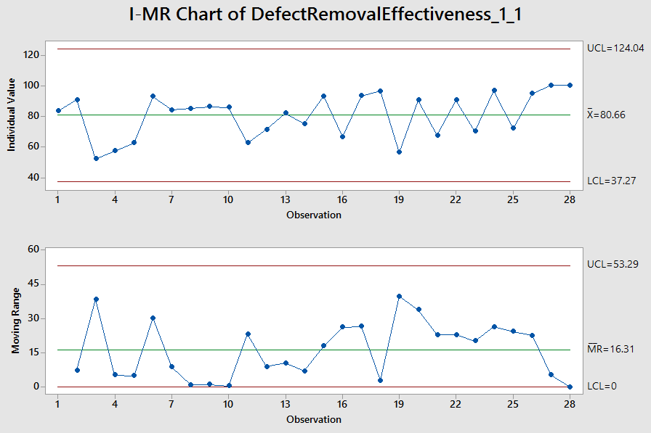
EbixHealth DEVELOPMENT
DEFECT REMOVAL EFFECTIVENESS

Slide 68
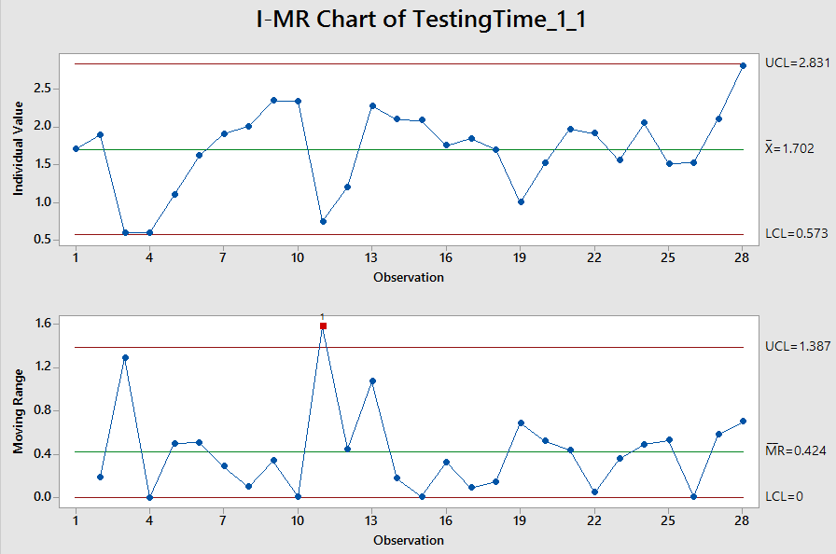
EbixHealth DEVELOPMENT TESTING TIME

Slide 69
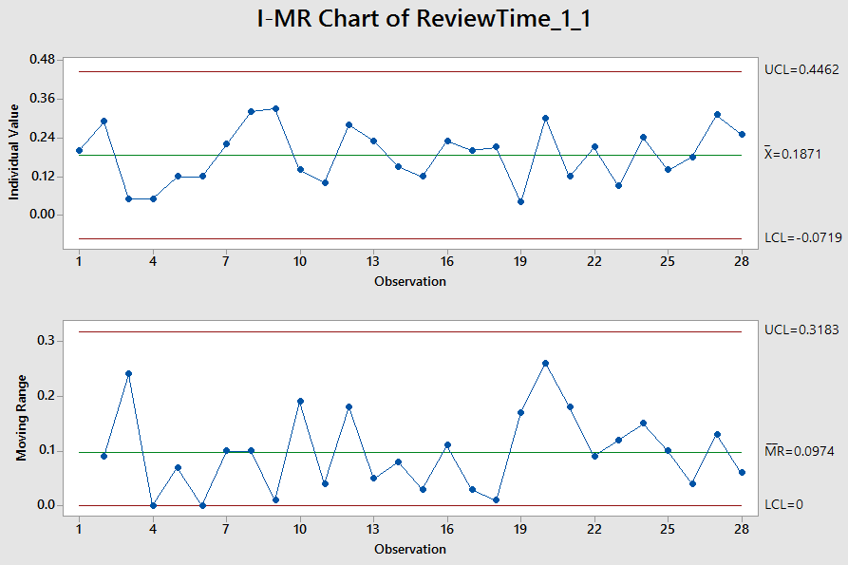
EbixHealth DEVELOPMENT REVIEW TIME

Slide 70
EbixHealth DEVELOPMENT
CURRENT BASELINE & EQUATION
On basis of I-MR Analysis, current baselines are-
 | UCL | Mean | LCL | SD
Defect Removal Effectiveness | 124.04 | 80.66 | 37.27 | 14.46
Testing Time | 2.83 | 1.70 | 0.57 | 0.38
Review Time | 0.45 | 0.19 | -0.07 | 0.09
Regression Equation –
Defect Removal Effectiveness (DRE) = 46.28 + 14.25 Testing Time + 54.4 Review Time

Slide 71
EbixHealth DEVELOPMENT DRE
PROCESS PERFORMANCE MODEL
Regression Equation –
DRE = 46.28 + 14.25 Testing Time + 54.4 Review Time
Predictor | Coef | SE Coef | T-Value | P-Value
Constant | 46.28 | 5.94 | 7.79 | 0.000
Testing Time | 14.25 | 4.11 | 3.47 | 0.002
Review Time | 54.4 | 26.1 | 2.09 | 0.047
S = 9.35774 R-Sq = 60.59% R-Sq (adj) = 57.44%
Analysis of Variance
Source | DF | Adj SS | Adj MS | F-Value | P-Value
Regression | 2 | 3365.9 | 1682.96 | 19.22 | 0.000
Residual Error | 25 | 2189.2 | 87.57
Total | 27 | 5555.1

Slide 72
EbixHealth DEVELOPMENT WHAT IF ANALYSIS
S. No. | Defect Removal Effectiveness | Testing Time | Review Time
1 | 80.71 | 1.70 | 0.19
2 | 82.1 | 1.75 | 0.2
3 | 83.9 | 1.8 | 0.22
4 | 86.24 | 1.85 | 0.25
5 | 87.5 | 1.9 | 0.26

Slide 73
EbixHealth DEVELOPMENT IMPROVEMENT TARGET
Setting improvement targets-
I | USL | Target Mean | LSL | SD
Defect Removal Effectiveness | 130.88 | 87.5 | 44.12 | 14.46
Testing Time | 3.03 | 1.9 | 0.77 | 0.38
Review Time | 0.52 | 0.26 | 0.00 | 0.09

Slide 74
EbixExchange DEVELOPMENT DATA FOR
DRE ANALYSIS
All Data points under EbixExchange Development group show 100% DRE.
X Factors are normal. Sustain current performance.

Slide 75
EbixExchange MAINTENANCE DATA FOR
DRE ANALYSIS
Actual Data | Defect Removal Effectiveness | 100 | 100 | 100 | 100 | 58.97 | 77.27 | 72 | 54.26 | 62.5
 | Testing Time | 0.45 | 0.45 | 1.77 | 0.66 | 0.79 | 1.16 | 0.92 | 0.85 | 0.39
 | Review Time | 0.3 | 0.13 | 0.35 | 0.44 | 0.14 | 0.06 | 0 | 0.07 | 0
Processed Data | Defect Removal Effectiveness | 95 | 100 | 100 | 80 | 58.97 | 77.27 | 72 | 54.26 | 62.5
 | Testing Time | 1.2 | 1.5 | 1.77 | 0.66 | 0.79 | 1.16 | 0.92 | 0.85 | 0.39
 | Review Time | 0.3 | 0.38 | 0.35 | 0.3 | 0.14 | 0.06 | 0.25 | 0.16 | 0.11
Actual Data | Defect Removal Effectiveness | 100 | 100 | 100 | 58.21 | 66.67 | 84.62 | 95.24 | 82.35
 | Testing Time | 1.65 | 0.95 | 2.76 | 0.41 | 0.53 | 0.62 | 2.55 | 5.42
 | Review Time | 0.11 | 0.38 | 0.09 | 0.03 | 0.01 | 0.01 | 0.09 | 0.06
Processed Data | Defect Removal Effectiveness | 100 | 100 | 100 | 58.21 | 66.67 | 84.62 | 95.24 | 82.35
 | Testing Time | 1.65 | 1.9 | 2.76 | 0.41 | 0.53 | 0.62 | 2.55 | 3
 | Review Time | 0.25 | 0.38 | 0.09 | 0.03 | 0.01 | 0.01 | 0.09 | 0.06

Slide 76
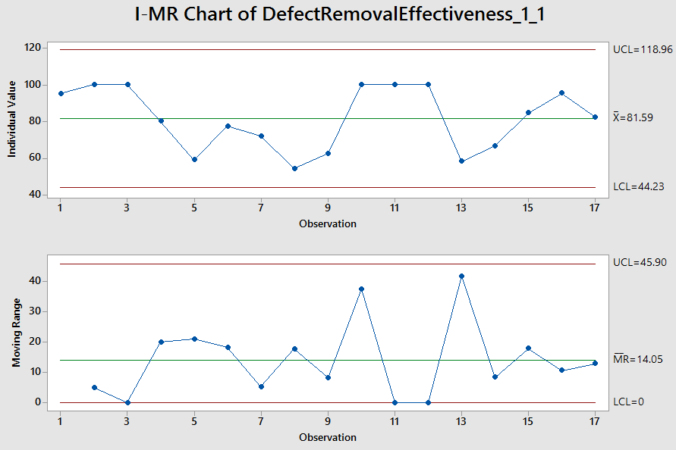
EbixExchange MAINTENANCE
DEFECT REMOVAL EFFECTIVENESS

Slide 77
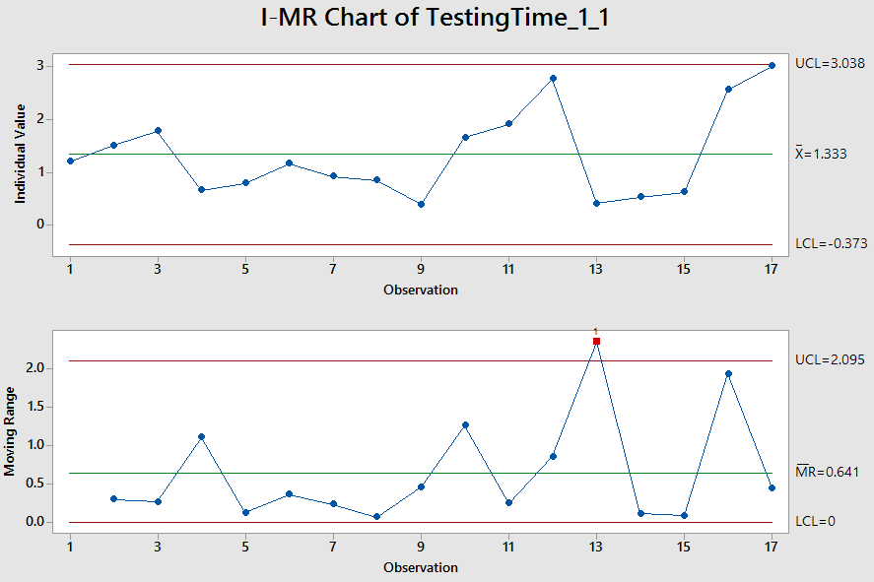
EbixExchange MAINTENANCE TESTING TIME

Slide 78
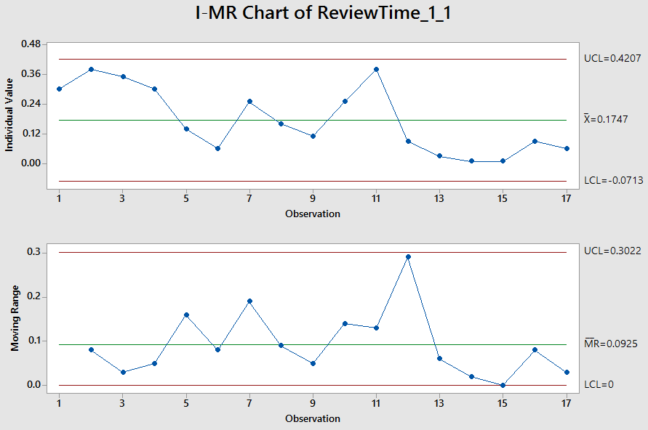
EbixExchange MAINTENANCE
REVIEW TIME

Slide 79
EbixExchange MAINTENANCE
CURRENT BASELINE & EQUATION
On basis of I-MR Analysis, current baselines are-
 | UCL | Mean | LCL | SD
Defect Removal Effectiveness | 118.96 | 81.59 | 44.23 | 12.46
Testing Time | 3.04 | 1.33 | -0.37 | 0.57
Review Time | 0.42 | 0.17 | -0.07 | 0.08
Regression Equation –
Defect Removal Effectiveness (DRE) = 54.78 + 12.63 Testing Time + 57.1 Review Time

Slide 80
EbixExchange MAINTENANCE DRE
PROCESS PERFORMANCE MODEL
Regression Equation –
DRE = 54.78 + 12.63 Testing Time + 57.1 Review Time
Predictor | Coef | SE Coef | T-Value | P-Value
Constant | 54.78 | 5.93 | 9.24 | 0.000
Testing Time | 12.63 | 3.26 | 3.87 | 0.002
Review Time | 57.1 | 20.5 | 2.78 | 0.015
S = 10.7774 R-Sq = 64.46% R-Sq (adj) = 59.36%
Analysis of Variance
Source | DF | Adj SS | Adj MS | F-Value | P-Value
Regression | 2 | 2949.8 | 1474.9 | 12.70 | 0.001
Residual Error | 14 | 1626.1 | 116.2
Total | 16 | 4576.0

Slide 81
EbixExchange MAINTENANCE
WHAT IF ANALYSIS
S. No. | Defect Removal Effectiveness | Testing Time | Review Time
1 | 81.59 | 1.33 | 0.17
2 | 82.11 | 1.35 | 0.18
3 | 83.31 | 1.4 | 0.19
4 | 84.51 | 1.45 | 0.2
5 | 86.29 | 1.5 | 0.22

Slide 82
EbixExchange MAINTENANCE IMPROVEMENT TARGET
Setting improvement targets-
I | USL | Target Mean | LSL | SD
Defect Removal Effectiveness | 123.66 | 86.29 | 48.92 | 12.46
Testing Time | 3.20 | 1.5 | -0.20 | 0.57
Review Time | 0.47 | 0.22 | -0.03 | 0.08

Slide 83
DRE IMPROVEMENT ACTION PLAN
Need to increase the effort spent on testing and at the same time ensuring that it leads to increase in Test Effectiveness and Test Efficiency (i.e. finding more and quality testing bugs in same amount of given time and reserving more time for testing).
Need to increase the efforts spent on reviews and at the same time ensuring that it leads to increase the Review Effectiveness and Review Efficiency (i.e. finding more and quality review bugs in same amount of given time and reserving more time for reviewing).
Need to include this increase in Testing Time and Review Time from planning stage itself by a potential modification/customization of Estimation model

Slide 84
DRE IMPROVEMENT ACTION PLAN CONTINUE..
4. Above mentioned points may be achieved by:
Preparing and following project specific testing and review guidelines.
By Training resources to conduct efficient reviews.
Capturing and implementing CDP details properly (SME review may require in addition to PEER review for certain identified work items).
By preparing and making test cases available before development.
5. Data should be correctly updated for UAT and Production environments in Testing Metric of iEmployee for correct calculation of DRE.

Slide 85
DRE IMPROVEMENT ACTION PLAN CONTINUE..
6. Improving synchronization between Timesheet data with Review metrics and Testing metrics data.
Improvement action plan to be shared with Leadership Task Force in review meetings and reports to be presented when suggestions are implemented.

